Slide 1
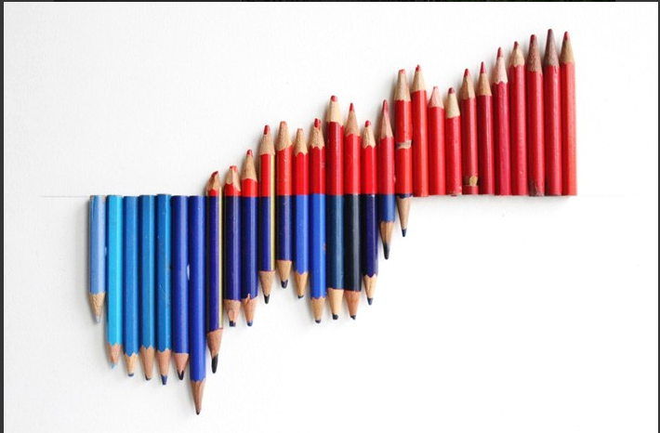

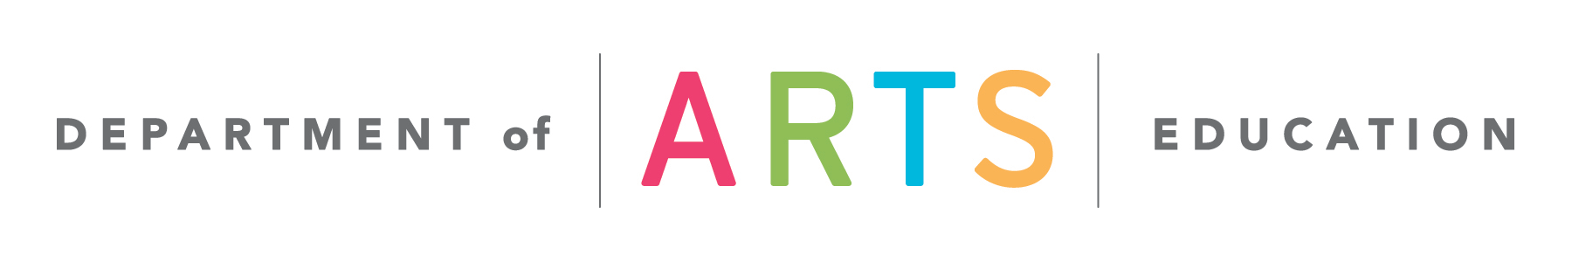
Quality Arts Assessments:
A Closer Look

Slide 2

Assessment: What’s the Point?
When done purposefully, thoughtfully, and skillfully, assessment can and should:
increase student interest and motivation to learn
help students develop a growth mindset
help both teachers and students understand students' learning styles and challenges
improve classroom instruction and student achievement
Notes:
Why assess students in the arts? The concept of assessment comes laden with negative connotations and associations, but done well, it can and should benefit both you and your students and be an extremely productive—and even inspiring—process.

Slide 3
Arts Assessment Misconception #1
✘ Success in the arts is too subjective to evaluate.
Achievement in the arts can be highly subjective, but there are many assessable aspects, including:
  Content: Can students demonstrate knowledge of traditions, history, vocabulary, and other factual information?
  Technique: Can students demonstrate specific measurable skills (e.g., playing correct notes in a piece of music; performing a plié in ballet)?
  Thinking / social behaviors: Do students demonstrate skills like inquiry, organization, collaboration, innovation, persistence?
Notes:
Here are some common misconceptions about assessment in the arts. Do you hold (or have you held) any of these to be true? Why?

Slide 4
Arts Assessment Misconception #2
✘ The end product is the most important thing to assess.
High-quality arts assessments:
  Examine student knowledge of the topic or subject
  The student’s artmaking process (how they create artwork)
  The student’s final product (the artwork itself)
Process-related criteria are emphasized, including:
  Effort and persistence through challenges
  Problem-solving ability
  Arts classroom behaviors (e.g., collaboration; peer critique)
Notes:
Here are some common misconceptions about assessment in the arts. Do you hold (or have you held) any of these to be true? Why?

Slide 5
Arts Assessment Misconception #3
✘ Assessment is contradictory to the artistic process.
Assessment is embedded in the artistic process (below). Real-world artists are consistently assessed by others and consistently self-assess to revise and improve their work.
MAKE
REVISE
CRITIQUE
REFLECT
Notes:
Here are some common misconceptions about assessment in the arts. Do you hold (or have you held) any of these to be true? Why?

Slide 6
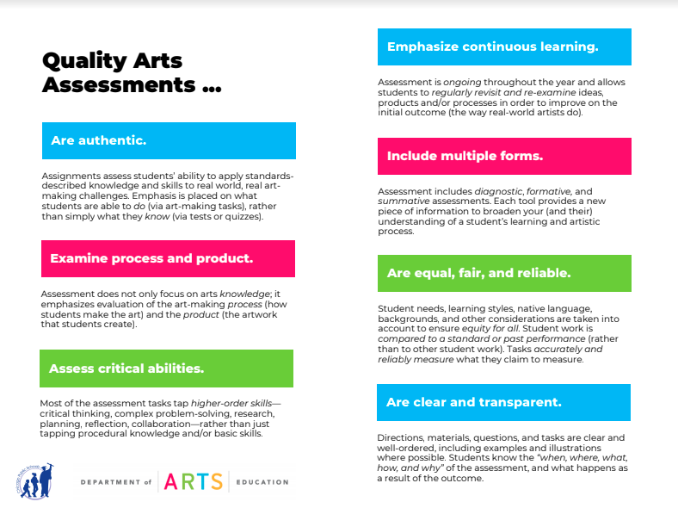
Best Practices
Quality arts assessments:
Are authentic.
Examine process and product.
Assess critical abilities.
Emphasize continuous learning.
Include multiple forms.
Are equal, fair, and reliable.
Are clear and transparent.
Notes:
The CPS Department of Arts Education has created this overview and checklist of research-based aspects of high-quality arts assessments. (NOTE: most of these best practices are true of assessment in other core subjects). The handout to the left, along with a self-diagnostic tool, is available at http://www.cpsarts.org/teachers/arts-instructional-resources/standards-toolkit/.
The following slides delve deeper into each best practice.

Slide 7
Best Practices
Quality arts assessments:
Are authentic.
Examine process and product.
Assess critical abilities.
Emphasize continuous learning.
Include multiple forms.
Are equal, fair, and reliable.
Are clear and transparent.
Assignments assess students’ ability to apply standards- described knowledge and skills to real world, real art-making challenges. Emphasis is placed on what students are able to do (via art-making tasks), rather than simply what they know (via tests or quizzes).
Notes:
Authentic arts assessments assess students’ ability to apply standards- described knowledge and skills to real world, real art-making challenges. Emphasis is placed on what students are able to do (via artmaking), rather than simply what they know (via tests or quizzes).

Slide 8
Is My Assessment Authentic?
Does the assessment allow students to receive valuable feedback and incorporate it into revisions of performances and products?
Does the assessment task resemble one found in the real world?
Does the task ask students to tackle complex problems and challenges and come up with innovative solutions?
Does the assessment strategy reflect the way real-world artists are evaluated or self-evaluate (e.g., a portfolio review, a performance critique, a personal reflection)?
Notes:
Here is a list of questions you can ask about the assessments you create for your students to determine whether or not they are authentic.

Slide 9
Is My Assessment Authentic?
Could the task provide content for a student’s portfolio (so that they graduate with a résumé of demonstrated accomplishments rather than just a transcript)?
Does the assessment strategy encourage student engagement and enthusiasm for learning and help them cultivate a growth mindset?
Will the assessment results genuinely help you adjust your instruction and help the student improve?
Notes:
Here is a list of questions you can ask about the assessments you create for your students to determine whether or not they are authentic.

Slide 10
Best Practices
Quality arts assessments:
Are authentic.
Examine process and product.
Assess critical abilities.
Emphasize continuous learning.
Include multiple forms.
Are equal, fair, and reliable.
Are clear and transparent.
Assessment does not only focus on students’ arts knowledge; it emphasizes evaluation of the art-making process (how students make the art) and the product (the artwork that students create).
Notes:
Arts assessments should evaluate students arts’ knowledge (understanding of facts, concepts, etc), artmaking processes (How did they make what they made? Why did they make it that way?) and students’ products (the actual artworks that they create).

Slide 11
Knowledge, Process, Product
Knowledge
Historical information
Cultural, traditional, background information
Other content/factual information
Vocabulary
Process
Effort
Problem-solving ability
Improvement/growth
Collaboration
Peer feedback
Self-motivation
Product
Performance
Work of art
Portfolio
Essay
Project
Presentation
Notes:
What do we mean by arts knowledge, process, and product? Mastery of all of these elements should be considered in quality assessments. Not every assessment has to evaluate all three simultaneously, but they should all be examined through a well-rounded suite of assessments.

Slide 12
Best Practices
Quality arts assessments:
Are authentic.
Examine process and product.
Assess critical abilities.
Emphasize continuous learning.
Include multiple forms.
Are equal, fair, and reliable.
Are clear and transparent.
Most of the assessment tasks tap higher-order skills—critical thinking, complex problem-solving, research, planning, reflection, collaboration— rather than just tapping procedural knowledge and/or basic skills.
Notes:
Quality assessments look for mastery of higher-order thinking skills like critical thinking, problem-solving, reflection, and collaboration, in addition to lower-order skills (procedural knowledge, factual recall).

Slide 13
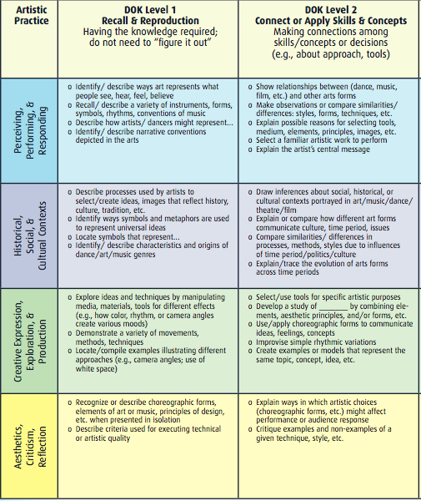
Higher-Order Skills
Hess’s Cognitive Rigor Matrix (Fine Arts) applies Webb’s DOK levels to modes of artistic practice (the artistic processes).
Artistic Practice | IL Arts Learning Standards Artistic Process(es)
Perceiving, Performing, & Responding | Performing, Presenting, Producing; Responding
Historical, Social, & Cultural Contexts | Connecting
Creative Expression, Exploration, & Production | Creating; Performing, Presenting, Producing
Aesthetics, Criticism, & Reflection | Responding
Notes:
How do students practice “higher-order skills” in the arts? Hess’s Cognitive Rigor Matrix applies Depth of Knowledge (DOK) levels to modes of artistic practice, which we can correlate to the four artistic processes outlined in the Illinois Arts Learning Standards.

Slide 14
Best Practices
Quality arts assessments:
Are authentic.
Examine process and product.
Assess critical abilities.
Emphasize continuous learning.
Include multiple forms.
Are equal, fair, and reliable.
Are clear and transparent.
Assessment is ongoing throughout the year and allows students to regularly revisit and re-examine ideas, products and/or processes to improve on the initial outcome (the way real-world artists do).
Notes:
Engagement in continuous learning is a regular practice of a real-world artist. Reflection, revision, and refinement of ideas is an integral part of an artist’s process. Assessments should reflect and reinforce this as often and as transparently as possible, and should mirror the ways that real-world artists engage in continuous learning (e.g., peer and self-critiques, revision, etc).

Slide 15
Best Practices
Quality arts assessments:
Are authentic.
Examine process and product.
Assess critical abilities.
Emphasize continuous learning.
Include multiple forms.
Are equal, fair, and reliable.
Are clear and transparent.
The assessment system includes diagnostic, formative, and summative assessments. Each tool provides a new piece of information to broaden your (and their) understanding of a student’s learning and artistic process.
Notes:
Assessment should be varied and delivered in multiple forms: diagnostic (whenever new concepts/skills are introduced, to gauge initial understanding / knowledge), formative (ongoing throughout instruction, to gauge learning of skills/concepts), and summative (at the end of units/projects, to measure achievement of objectives).

Slide 16
Multiple Forms of Assessment
DIAGNOSTIC
Identify knowledge and misconceptions
Before/during instruction
SUMMATIVE
Measure achievement of objectives
After instruction
FORMATIVE
Monitor progress and adjust instruction
During instruction

Slide 17
Multiple Forms of Assessment
Self-assessment
Performance
Pretest
Portfolio
DIAGNOSTIC
Identify knowledge and misconceptions
Before/during instruction
SUMMATIVE
Measure achievement of objectives
After instruction
KWL chart
Presentation
Discussion
Essay
Poll
Capstone project
FORMATIVE
Monitor progress and adjust instruction
During instruction
Observation
Discussion
Journal
Critique
Conference
“Processfolio”
Notes:
Each type of assessment can take multiple forms. Note, too, that each of these types of assessment can be co-designed with, or fully designed by, your students to promote full ownership over the learning process.

Slide 18
Best Practices
Quality arts assessments:
Are authentic.
Examine process and product.
Assess critical abilities.
Emphasize continuous learning.
Include multiple forms.
Are equal, fair, and reliable.
Are clear and transparent.
Student needs, learning styles, native language, backgrounds, and other considerations are taken into account to ensure equity for all. Student work is compared to a standard or past performance (rather than to other student work). Tasks accurately and reliably measure what they claim to measure.
Notes:
Assessments should take into account student needs, learning styles, languages, backgrounds, and other considerations and be differentiated accordingly. All student work should be compared to a standard or to that student’s past performance (rather than to other student work). The tasks given should accurately and reliably measure what they say they are measuring. For more information: https://www.thegraidenetwork.com/blog-all/2018/8/1/the-two-keys-to-quality-testing-reliability-and-validity

Slide 19
Equal, Fair, Reliable Assessments
are accurate in evaluating students’ abilities and can do so reliably across testing contexts and scorers
are free from bias
are designed to reduce obstacles to performance for certain groups (Example: No complex, topic-irrelevant language that could pose issues for ELL/ESL students)
are designed with accommodations and modifications to create maximum access for a wide range of learners
are designed to enable the widest range of students to show what they know and how they’ve progressed
From Darling-Hammond, L., et. al. (2013). Criteria for High-Quality Assessment.
Notes:
These are some further characteristics of equal, fair, and reliable assessments.

Slide 20
Best Practices
Quality arts assessments:
Are authentic.
Examine process and product.
Assess critical abilities.
Emphasize continuous learning.
Include multiple forms.
Are equal, fair, and reliable.
Are clear and transparent.
Directions, materials, questions, and tasks are clear and well-ordered, including examples and illustrations where possible. Students know the “when, where, what, how, and why” of the assessment, and what happens as a result of the outcome.
Notes:
Finally, quality assessments are clear, well-organized, and transparent to students. Students understand when, where, and how they will be assessed, what they will be assessed on, and why they are being assessed. They are also clear on what will happen as a result of the outcomes of assessment. In short: Quality assessments should make a student want to learn and grow, rather than making them feel defeated, confused, or as though they are just part of a meaningless compliance exercise.

Slide 21
Clear and Transparent Assessments
Easier tasks or items come first; more difficult tasks come later
Instructions and directions are easy for students to follow
Where possible, examples and images are included to help students understand what’s expected of them
Students know when, where, and how the assessment will be conducted, and how it will be judged/scored/weighted
Students know what happens as a result of the outcomes
Where possible, students are involved in creating rubrics, checklists, and other criteria
Notes:
One surefire way to promote clarity and transparency is to give students more control over aspects of their assessments. Can you find a way to include them in determining how, when, and where they are assessed? Can you include them in determining the criteria on which they are evaluated, and what happens as a result of the evaluation?

Slide 22

Key Sources
Taking Full Measure: Rethinking Assessment in the Arts, Dennie Palmer Wolf & Nancy Pistone
Assessment in Arts Education, Donna Kay Beattie
Arts Assessment Resource Guide,
San Diego County Office of Education
Educative Assessment: Designing Assessment to Inform and Improve Student Performance, Grant Wiggins
Notes:
The following key sources were consulted to create this professional learning session on quality assessment in the arts.

Slide 23

Other Assessment Resources
Cornerstone Assessments
Standards-based assessments in Dance, Media Arts, Music, Theatre, and Visual Arts for Grades 2, 5, 8, and HS, created by the National Coalition for Core Arts Standards (NCCAS)
nationalartsstandards.org
Arts Assessment for Learning Formative assessment tools and resources created by over 200 New York City
arts educators
artsassessmentforlearning.org
Education Closet
Tools, strategies, articles, and other resources for arts integration assessment
educationcloset.com
Notes:
The following sites offer examples, templates, tools, and further information related to quality arts assessments.

